Slide 1
OSI
Model and
TCP/IP protocol suite)
CSE306

Slide 2

Tasks involved in sending a letter

Slide 3
THE OSI MODEL
Established in 1947, the International Standards Organization (ISO) is a multinational body dedicated to worldwide agreement on international standards. An ISO standard that covers all aspects of network communications is the Open Systems Interconnection (OSI) model. It was first introduced in the late 1970s.
Topics discussed in this section:
Layered Architecture
Peer-to-Peer Processes
Encapsulation

Slide 4
ISO is the organization.
OSI is the model.

Slide 5

Seven layers of the OSI model

Slide 6

The interaction between layers in the OSI model

Slide 7

An exchange using the OSI model

Slide 8
IEEE 802.3
Divide into two category
Baseband and Broadband
IEEE (Institute of Electrical and Electronics Engineers)
Base :- Specific for Digital Signal
Broad:- Specific for Analog Signal
IEEE divides the baseband category into 5 different standards
10 Base 5 (10Mbps transmission speed and 500 meters as the maximum segment length.)
10 Base 2
10 Base T
1 Base 5
100 Base T
Note:-
First Number indicate the data rate in mbps
Last Number indicate the maximum cable length
Where T stands for Twisted Pair Cable
IEEE Broadband category
10 Base 36

Slide 9
LAYERS IN THE OSI MODEL
In this section we briefly describe the functions of each layer in the OSI model.
Topics discussed in this section:
Physical Layer
Data Link Layer
Network Layer
Transport Layer
Session Layer
Presentation Layer
Application Layer

Slide 10

Physical layer

Slide 11
The physical layer is responsible for movements of
individual bits from one hop (node) to the next.

Slide 12
Physical layer
Type of transmission media
Representation of bits
Data rate
Synchronization of bits
Line Configuration
Topology
Transmission mode

Slide 13

Data link layer

Slide 14
The data link layer is responsible for moving
frames from one hop (node) to the next.

Slide 15
Data link layer
Framing
Physical addressing
Flow control
Error control
Access control

Slide 16

Hop-to-hop delivery
Example 'tracert’ command

Slide 17

Network layer

Slide 18
The network layer is responsible for the
delivery of individual packets from
the source host to the destination host.

Slide 19
Network layer
Logical addressing
Routing

Slide 20

Source-to-destination delivery

Slide 21

Transport layer

Slide 22
The transport layer is responsible for the delivery
of a message from one process to another.

Slide 23
Transport layer
Service-point addressing
Segmentation and reassembly
Connection control
Flow control
Error control

Slide 24

Reliable process-to-process delivery of a message

Slide 25

Session layer

Slide 26
The session layer is responsible for dialog
control and synchronization.

Slide 27
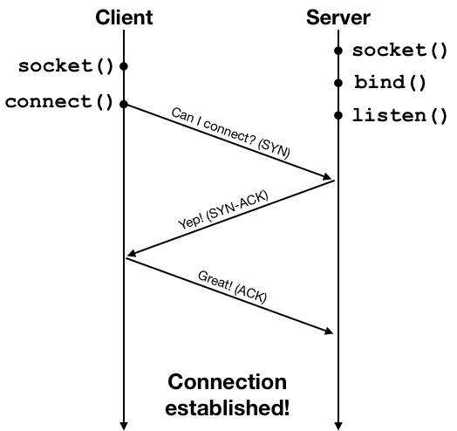
Session layer
Dialog control (Session layer is used to create, maintain and terminate sessions between client and server)
Synchronization (A connection is established by what is known as a three-way handshake process. The client initiates the connection request using a network packet, and then the server and the client exchange one round of acknowledgment packets to establish the connection.)

Slide 28

Presentation layer

Slide 29
The presentation layer is responsible for translation, compression, and encryption.

Slide 30
Presentation layer
Translation
Encryption
Compression

Slide 31

Application layer

Slide 32
The application layer is responsible for
providing services to the user.

Slide 33
Application layer
Network Virtual Terminal
File transfer, access, and management.
Mail services
Directory Services

Slide 34

Summary of layers

Slide 35
TCP/IP PROTOCOL SUITE
The layers in the TCP/IP protocol suite do not exactly match those in the OSI model. The original TCP/IP protocol suite was defined as having four layers: host-to-network, internet, transport, and application. However, when TCP/IP is compared to OSI, we can say that the TCP/IP protocol suite is made of five layers: physical, data link, network, transport, and application.

Slide 36

TCP/IP and OSI model
Note:- Stream Control Transmission Protocol (SCTP) is a transport-layer protocol that ensures reliable, in-sequence transport of data. SCTP has more secure data transfer.

Slide 37
ADDRESSING
Four levels of addresses are used in an internet employing the TCP/IP protocols: physical, logical, port, and specific.

Slide 38

Addresses in TCP/IP

Slide 39
Physical Addresses
The physical address, also known as the link address, is the address of a node as defined by its LAN or WAN.
The size and format of these addresses vary depending on the network. For example, Ethernet uses a 6-byte (48-bit) physical address.
Physical addresses can be either unicast (one single recipient), multicast (a group of recipients), or broadcast (to be received by all systems in the network.
Example: Most local area networks use a 48-bit (6-byte) physical address written as 12 hexadecimal digits; every byte (2 hexadecimal digits) is separated by a colon, as shown below: A 6-byte (12 hexadecimal digits) physical address 07:01:02:01:2C:4B
Logical Addresses
Logical addresses are used by networking software to allow packets to be independent of the physical connection of the network, that is, to work with different network topologies and types of media.
A logical address in the Internet is currently a 32-bit address that can uniquely define a host connected to the Internet. An internet address in IPv4 in decimal numbers 132.24.75.9
No two publicly addressed and visible hosts on the Internet can have the same IP address.
The physical addresses will change from hop to hop, but the logical addresses remain the same.
The logical addresses can be either unicast (one single recipient), multicast (a group of recipients), or broadcast (all systems in the network). There are limitations on broadcast addresses.
Port Addresses
There are many application running on the computer. Each application run with a port no.(logically) on the computer.
A port number is part of the addressing information used to identify the senders and receivers of messages.
Port numbers are most commonly used with TCP/IP connections.
These port numbers allow different applications on the same computer to share network resources simultaneously.
The physical addresses change from hop to hop, but the logical and port addresses usually remain the same.
Example: a port address is a 16-bit address represented by one decimal number 753
Application-Specific Addresses
Some applications have user-friendly addresses that are designed for that specific application.
Examples include the e-mail address (for example, param@lpu.co.in) and the Universal Resource Locator (URL) (for example, www.lpu.in). The first defines the recipient of an e-mail; the second is used to find a document on the World Wide Web.

Slide 40

Relationship of layers and addresses in TCP/IP

Slide 41
Comparison of the OSI and TCP/IP Reference Models
Functionality of the layers is roughly similar
Concepts central to OSI model
Services : The service definition tells what the layer does, not how entities above it access it . It defines the layer's semantics.
Interfaces : tells the processes above it how to access it. It specifies what the parameters are and what results to expect
Protocols: the layer's own business.

Slide 42
Comparison of the OSI and TCP/IP Reference Models
OSI reference model was devised before the corresponding protocols were invented. This ordering means that the model was not biased toward one particular set of protocols
In TCP/IP, the protocols came first, and the model was really just a description of the existing protocols
Number of layers: the OSI model has seven layers and the TCP/IP has four layers.
The TCP/IP model has only one mode in the network layer (connectionless) but supports both modes in the transport layer.

